Slide 1
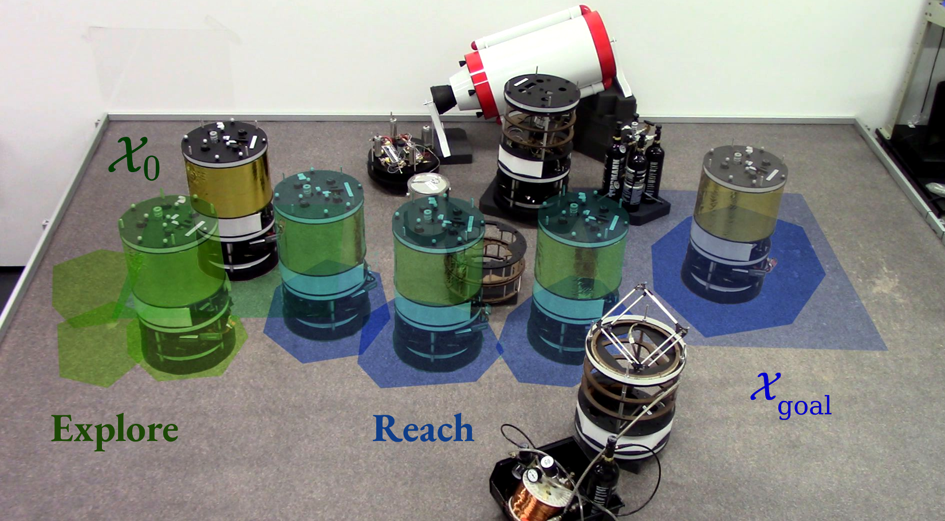
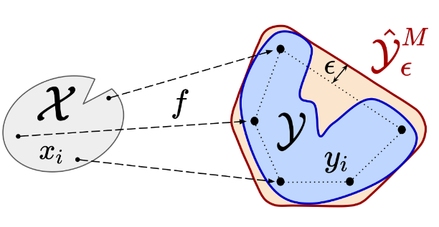


Uncertainty-aware control strategies for
safe learning-based robotic autonomy
Thomas Lew
May 2022

Slide 2

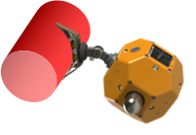
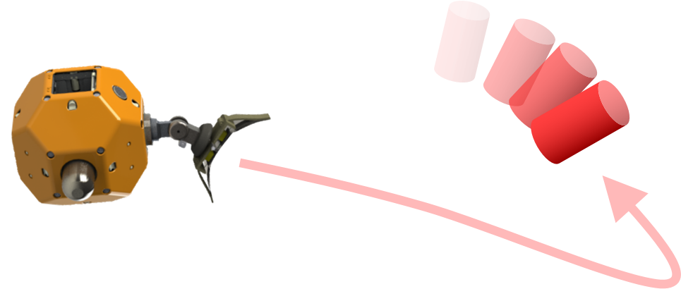
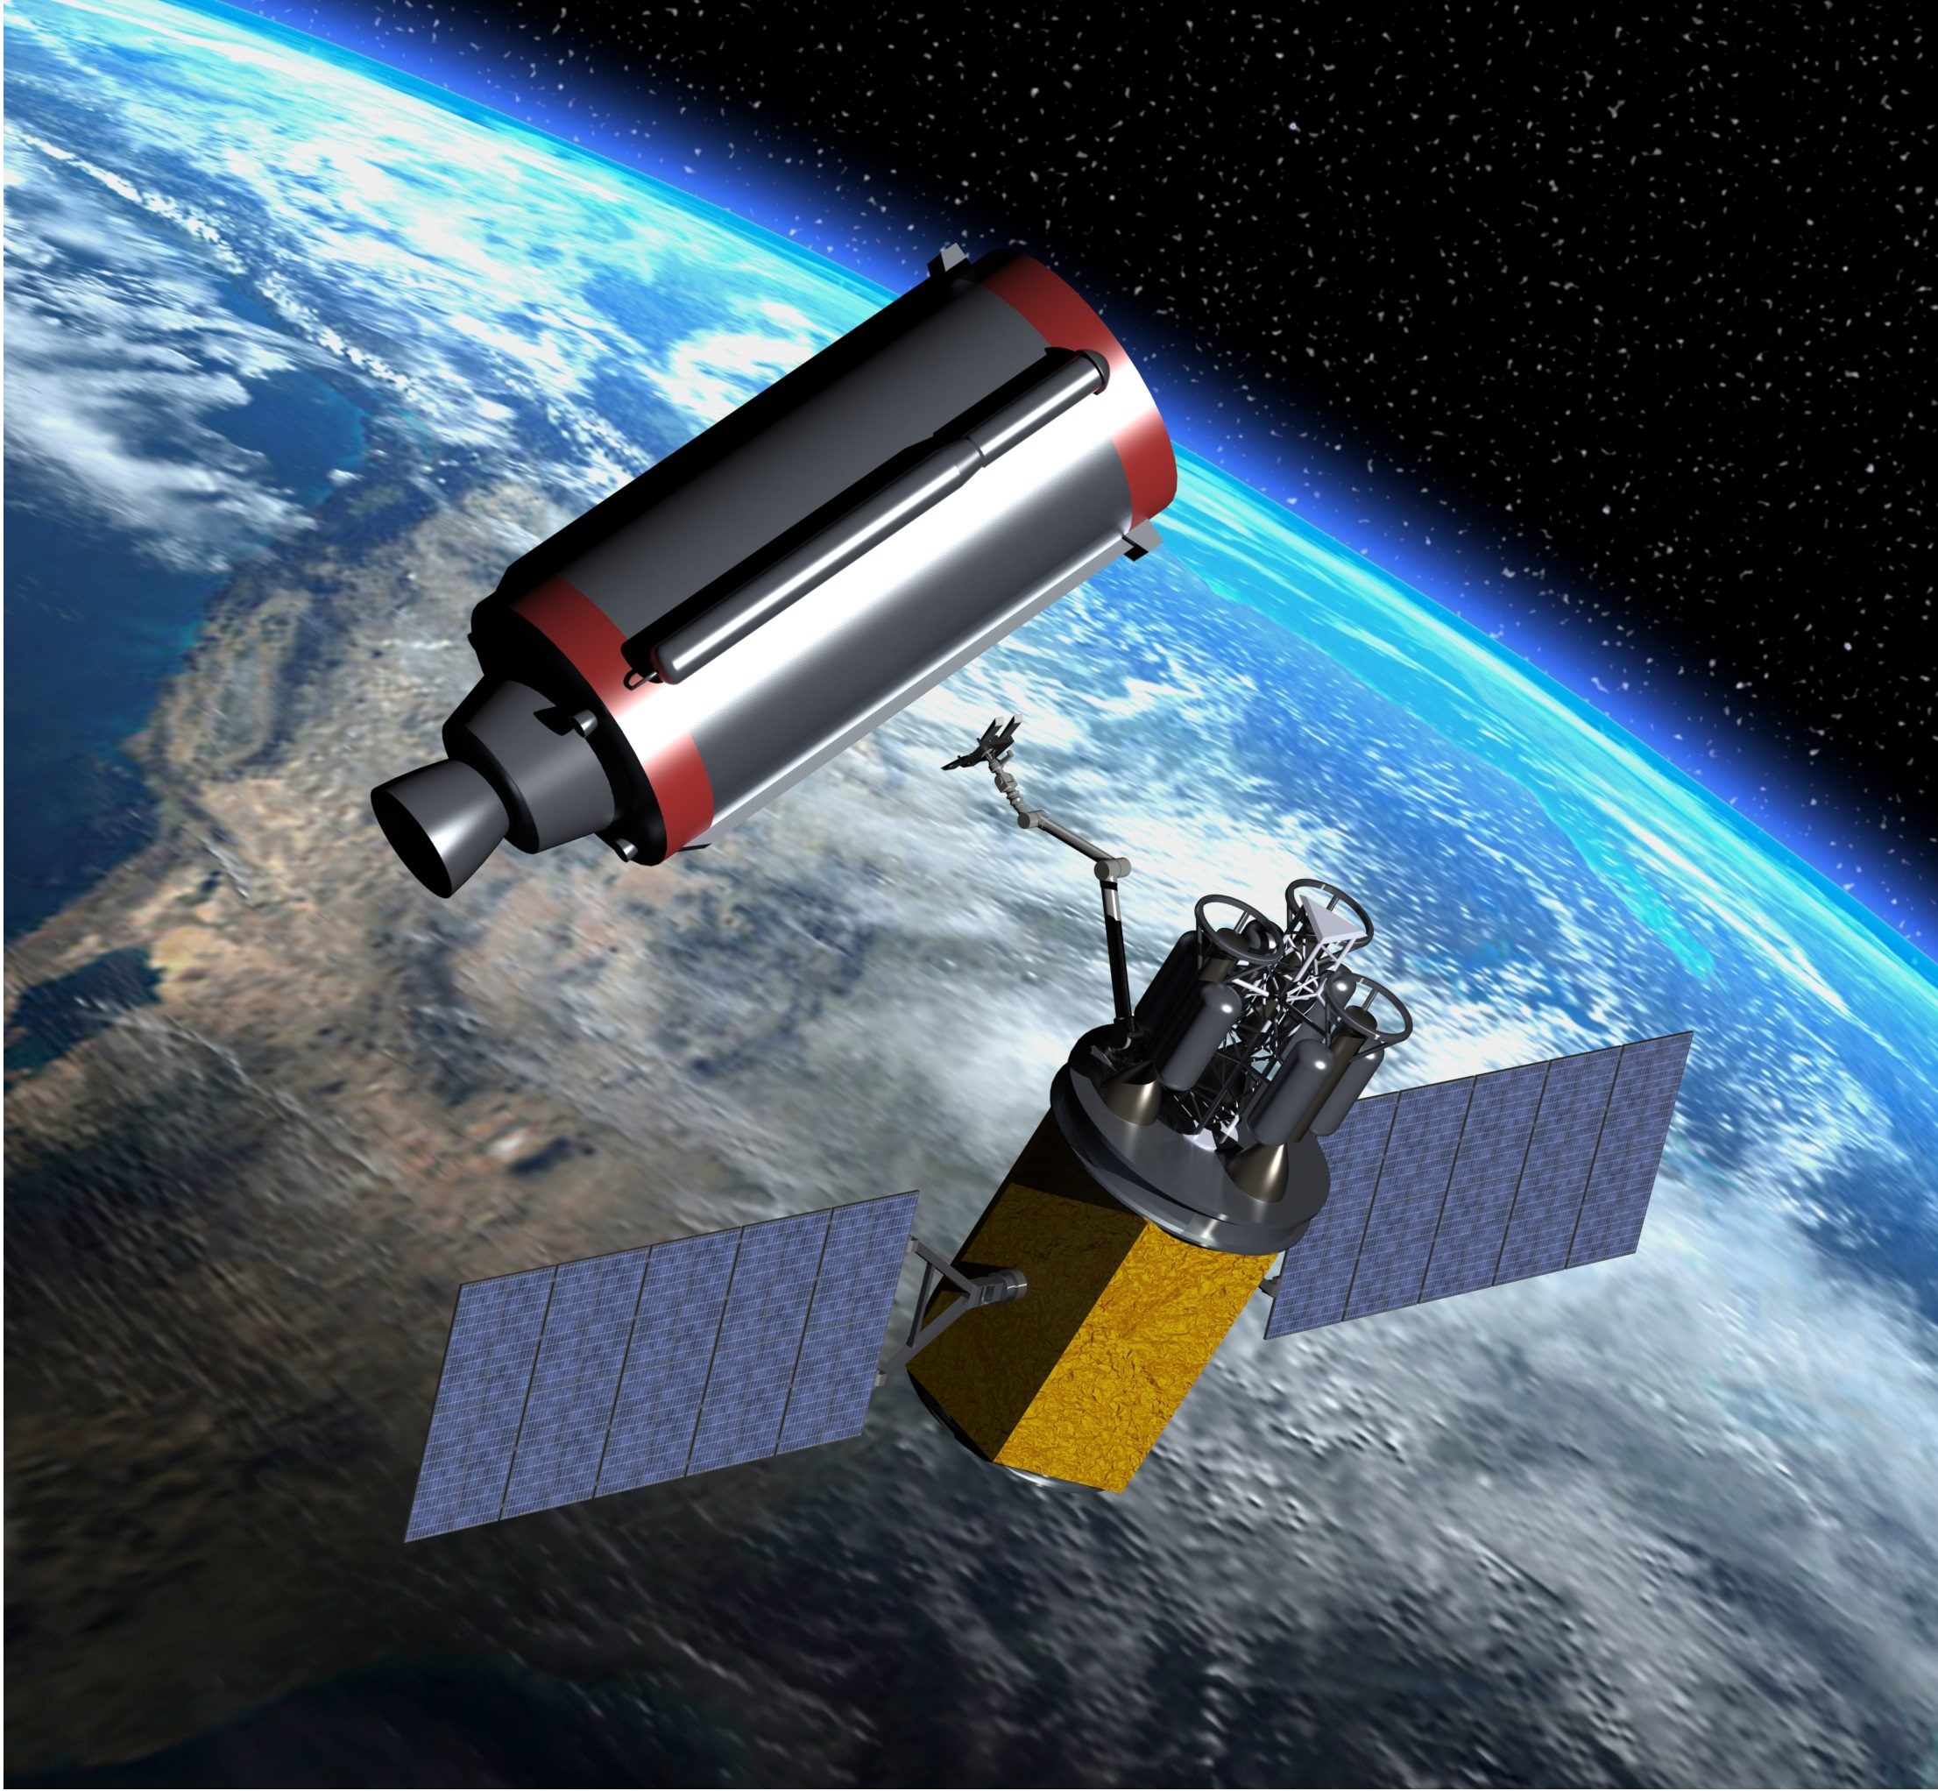

Robotic autonomy in space

Slide 3
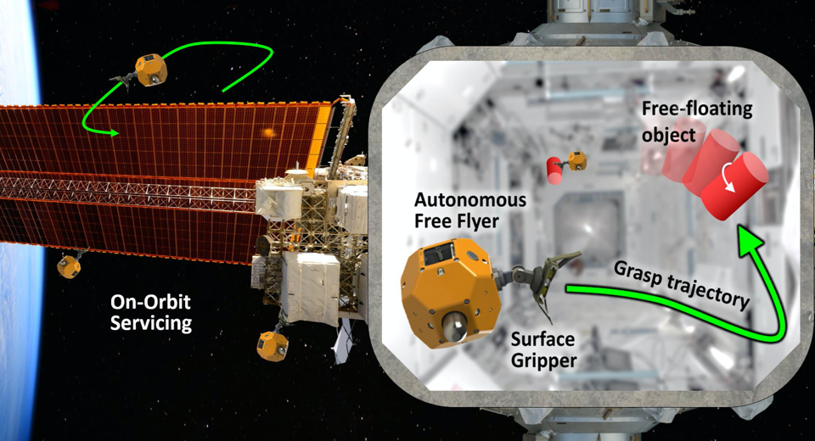
Notes:
Assistive free-flyers in space: perching for inspection / monitoring, tool retrieval and return, unpacking cargo, on-orbit servicing / assembly

Slide 4
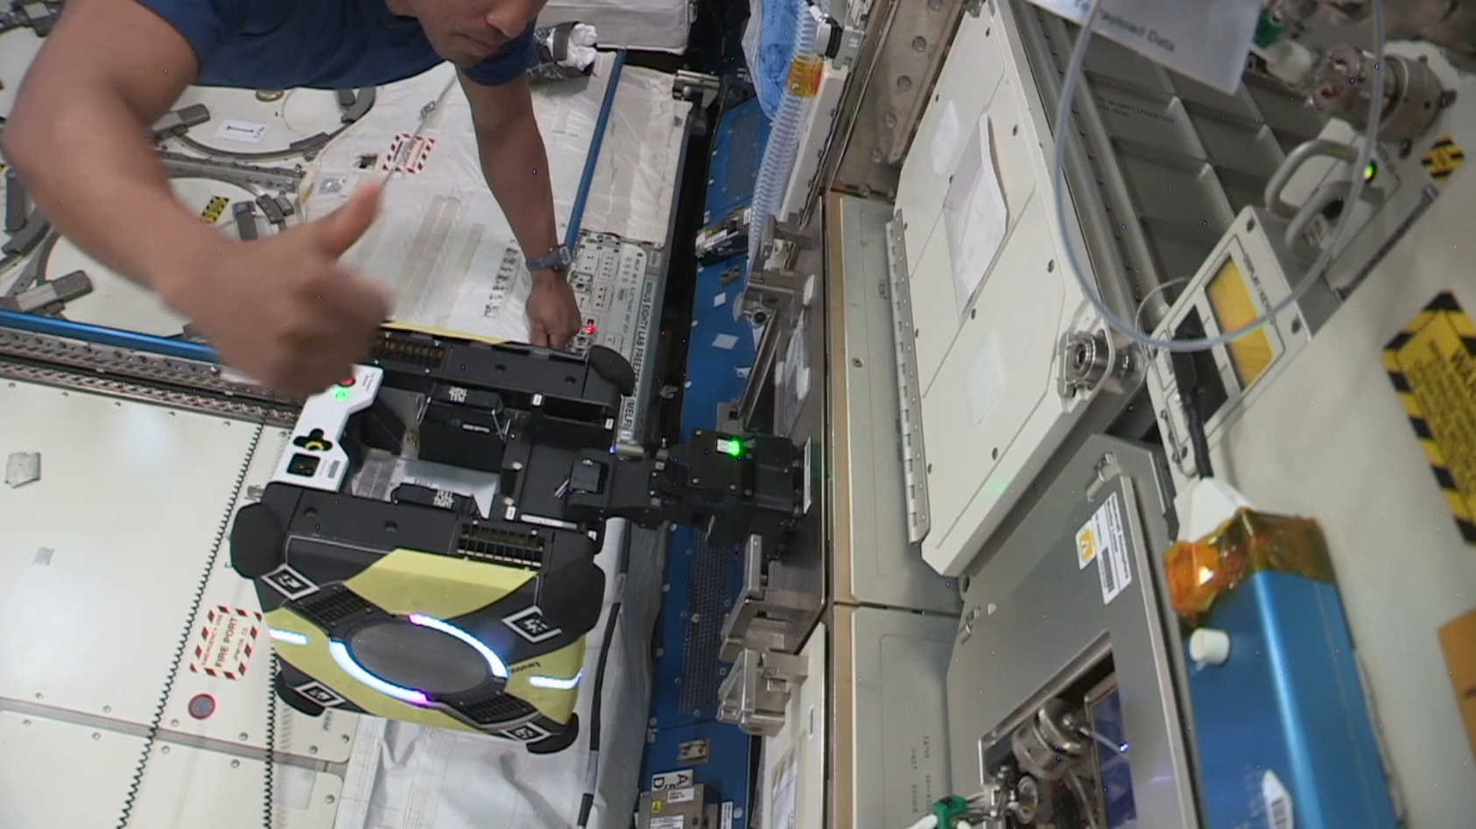
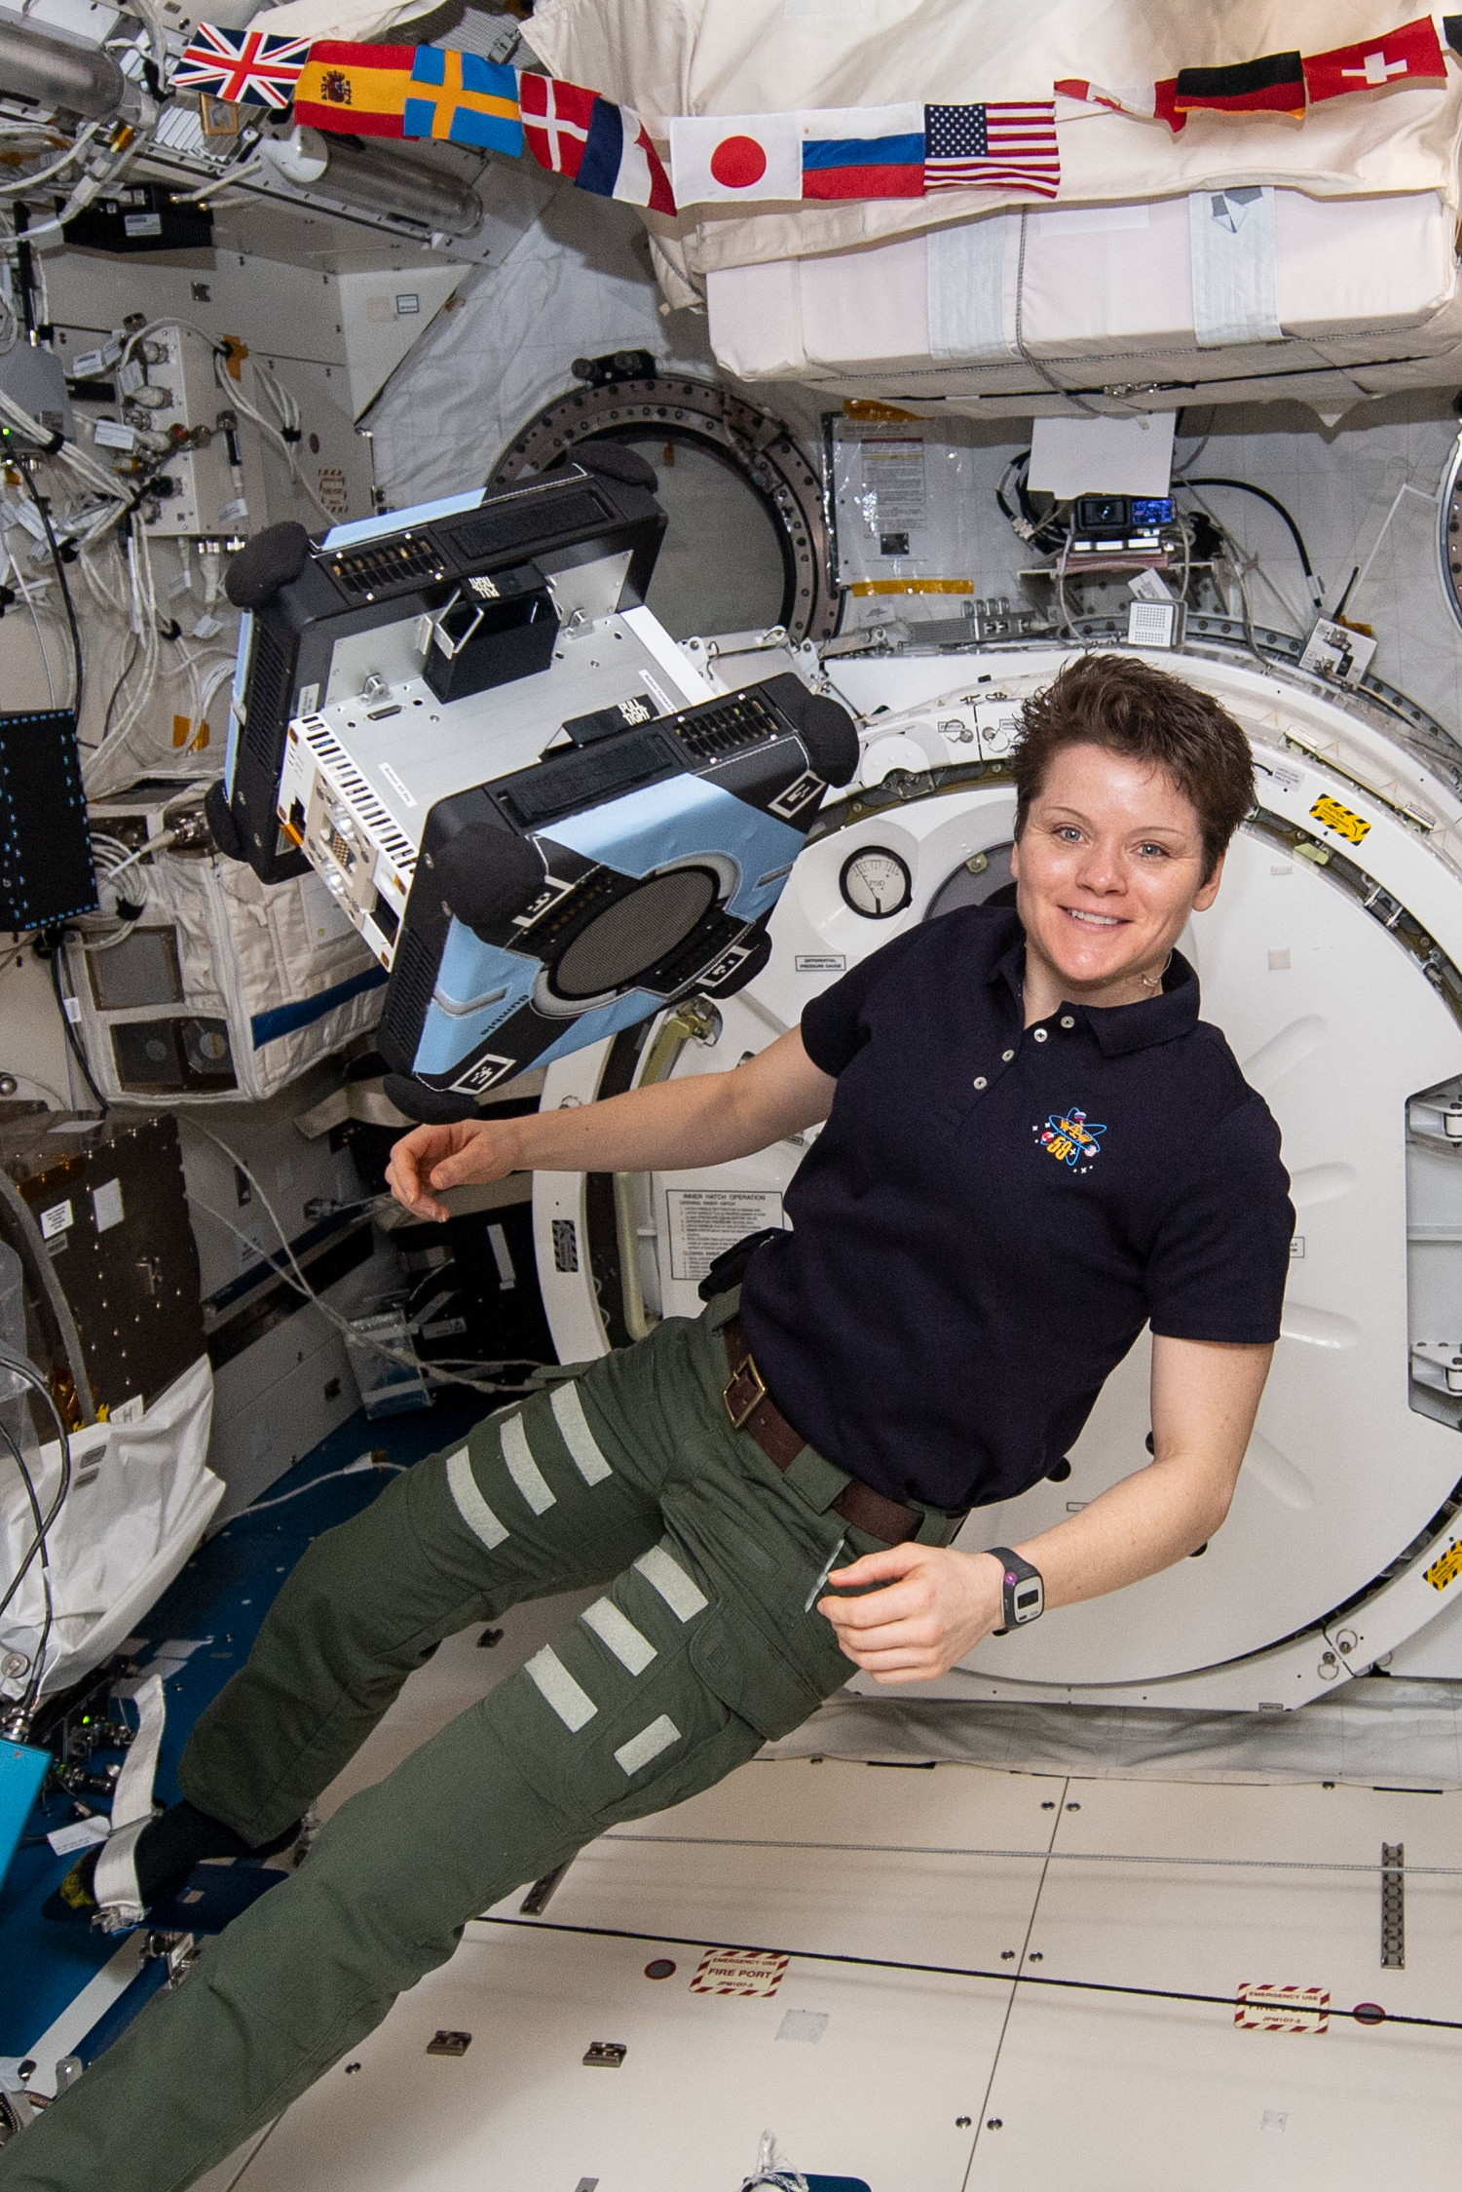
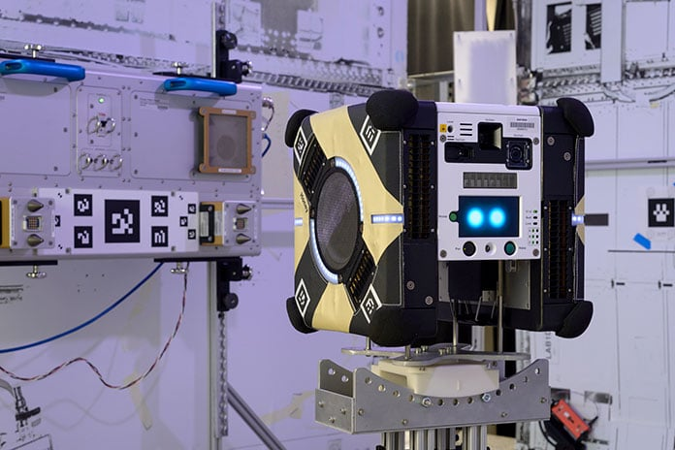





NASA Astrobee free-flying robots on-board the ISS
Astronaut McClain with Astrobee.

Slide 5
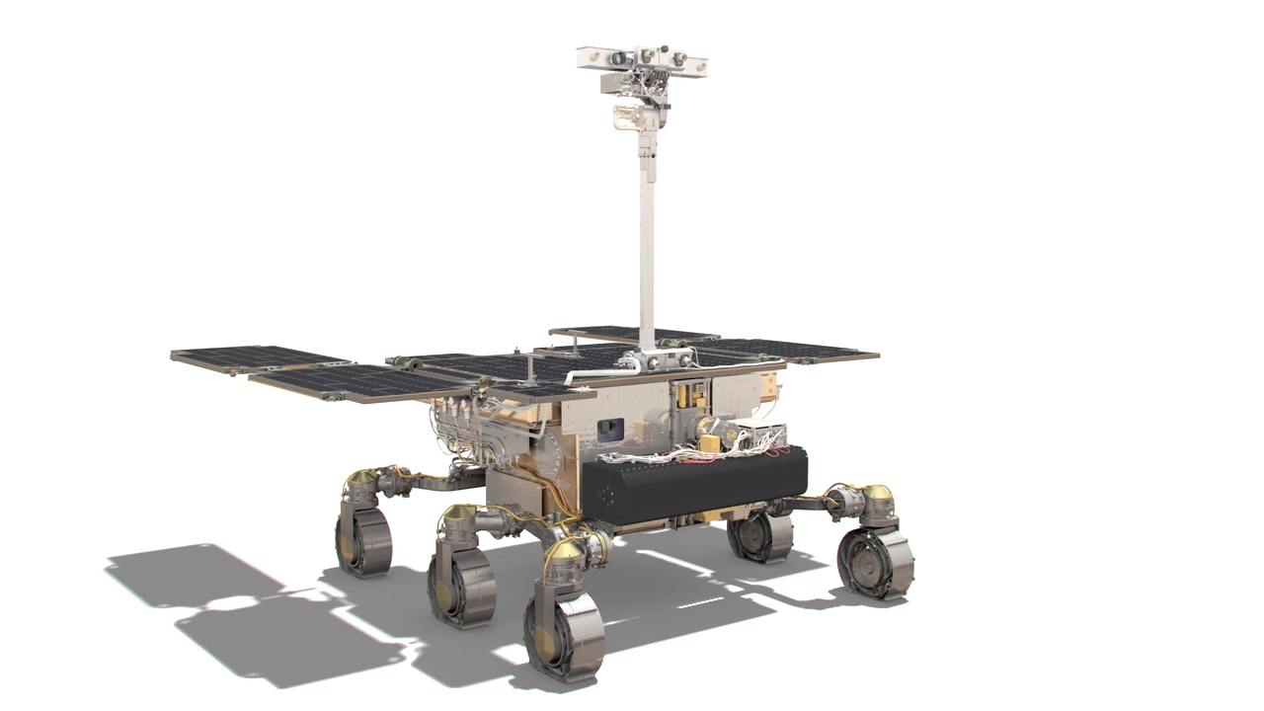
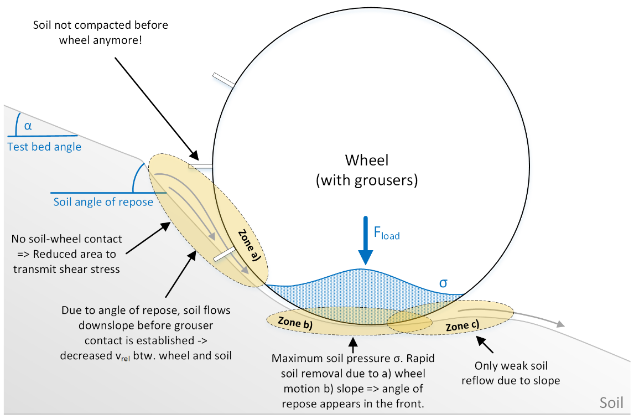
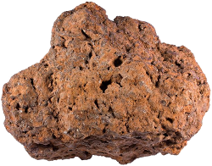

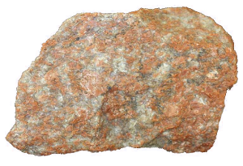
Robotic autonomy: challenges
Uncertain dynamics (unknown payload properties and flexible grasp)
Safe use of learning-based components?
Accounting for uncertainty?
Loose Soil

Slide 6
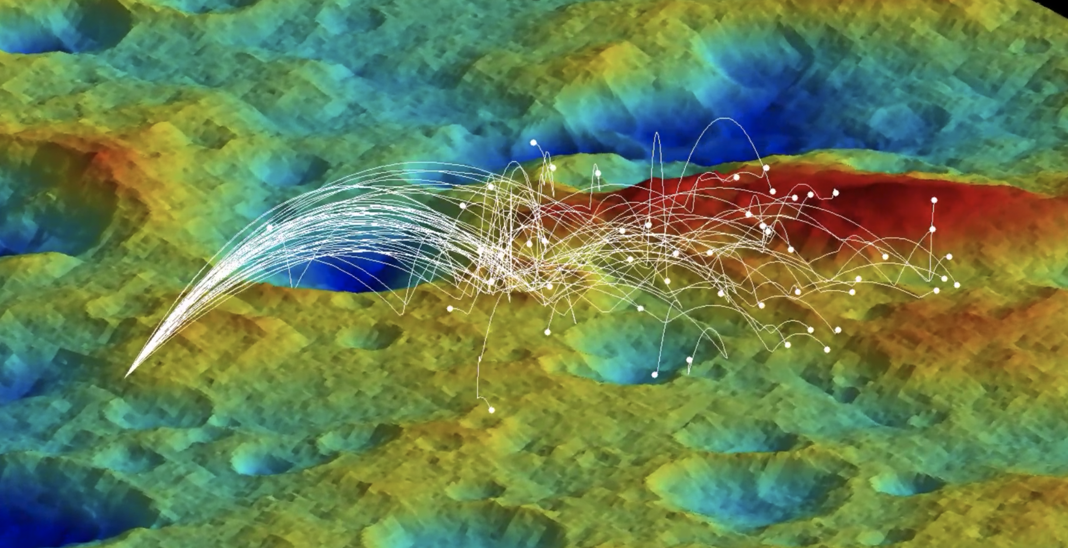
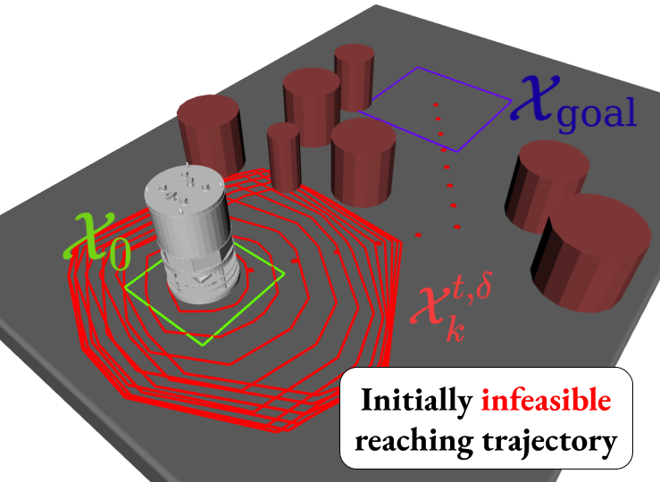
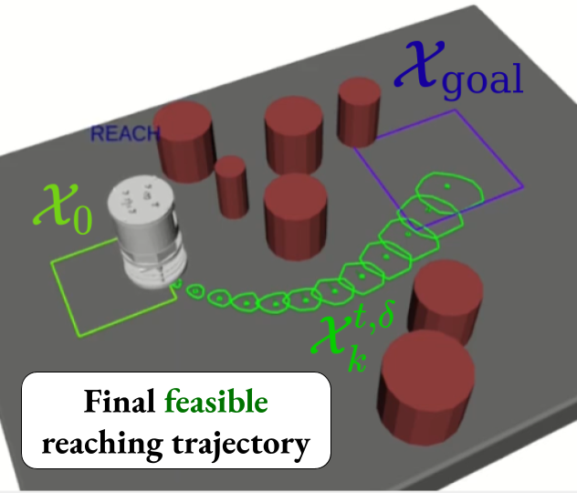
Towards safe learning-based robotic autonomy
safe active dynamics
learning and control
sampling-based
reachability analysis
1
2

Slide 7
Towards safe learning-based robotic autonomy
safe active dynamics
learning and control
sampling-based
reachability analysis
1
2

Slide 8
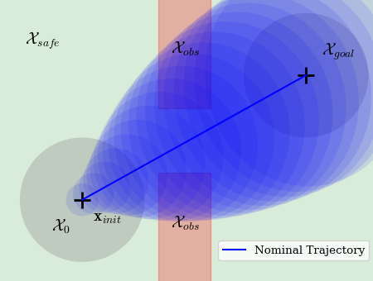
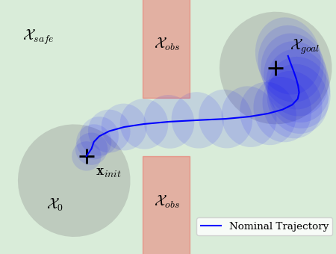
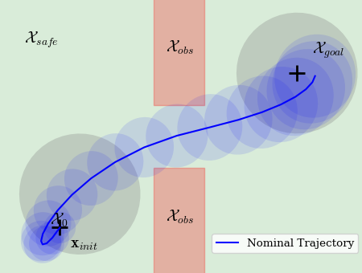
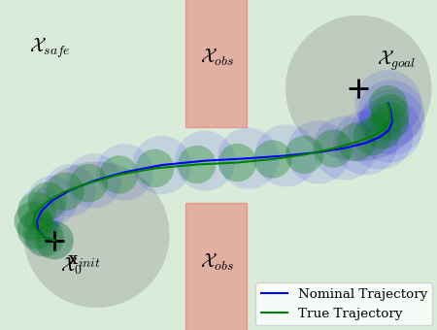
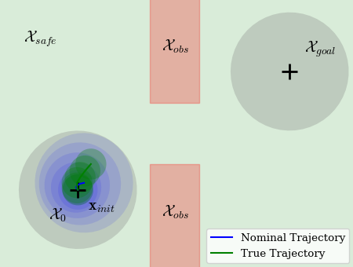
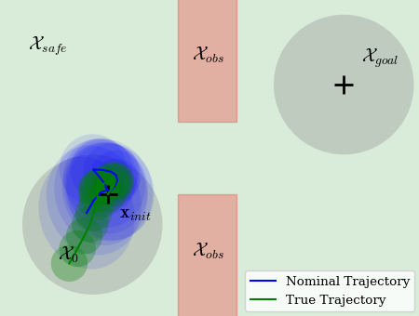
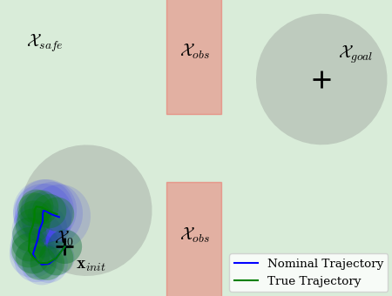
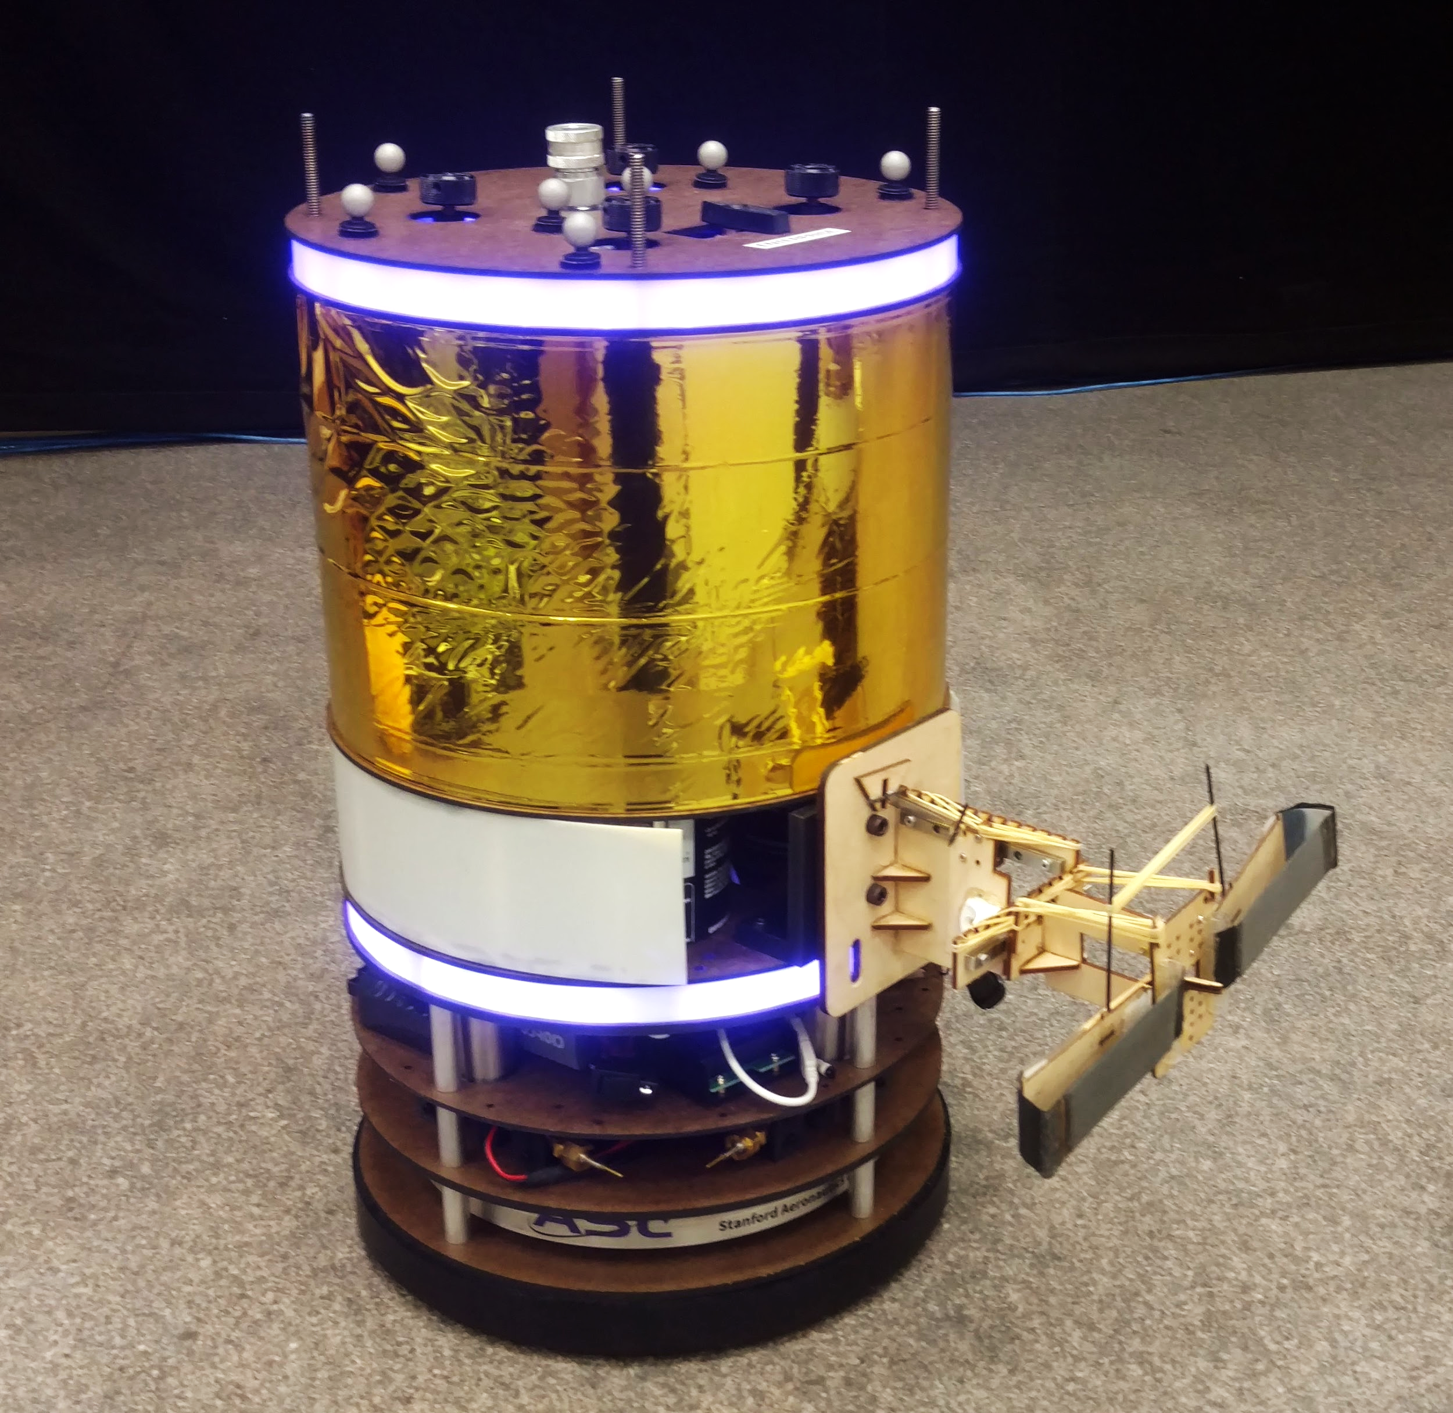

Uncertainty may be too high and cause infeasibility
4
...
infeasible
infeasible
infeasible
feasible 1
=> first, gather data to learn and reduce uncertainty
free-flyer space robot with uncertain payload
1
2
3
feasible 1
feasible 1
feasible 1
Lew, Sharma, Harrison, Bylard, Pavone. Safe Active Dynamics Learning and Control: A Sequential Exploration-Exploitation Framework. IEEE T-RO, 2022

Slide 9

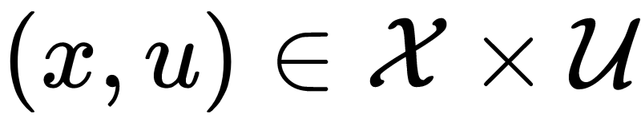
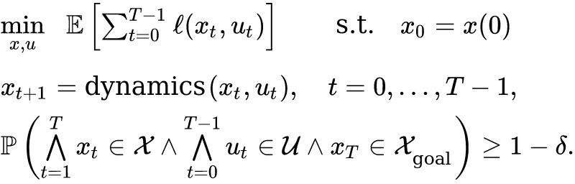
Problem formulation
Uncertain dynamics
Constraints
State
Control
Parameters
Disturbances
(bounded)
Notes:
Ongoing work with continuous time formulation with an SDE

Slide 10
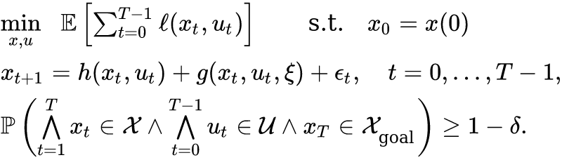
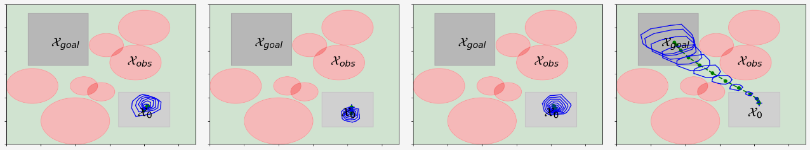

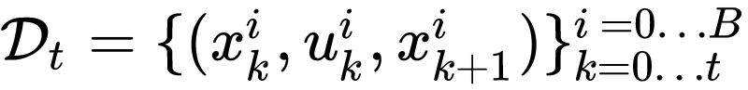
Problem formulation
Additional knowledge:
Control-invariant set
Prior data

Slide 11
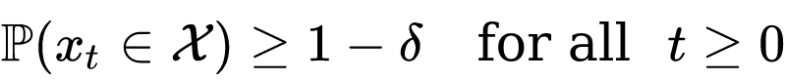
Related work
Approaches to learn a model / controller to improve performance
Reinforcement learning (e.g., Hwangbo et al, 2019)
Learning-based MPC (e.g, Deisenroth et al, 2015. Koller et al, 2018)
Learning-based control barrier functions (e.g., Khojasteh et al, 2020)
Dual control typically does not consider constraints (e.g., Mania et al, 2020)
We enforce a joint chance constraint
which gives stronger guarantees than pointwise chance constraints

Slide 12
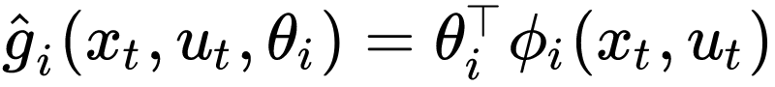
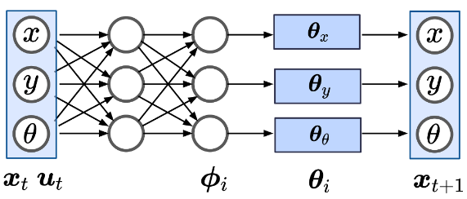



Modeling: linear meta-learning
Uncertain dynamics
Approximate model
train a model capable of rapid adaptation
Harrison, Sharma, Pavone. “Meta-Learning Priors for Efficient Online Bayesian Regression,” WAFR, 2018

Slide 13
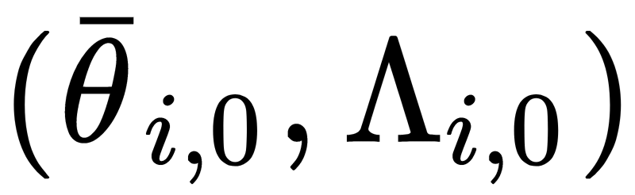
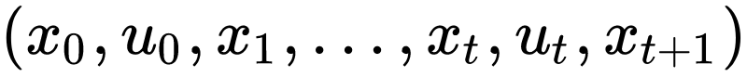
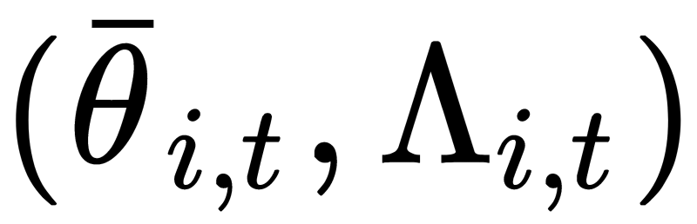
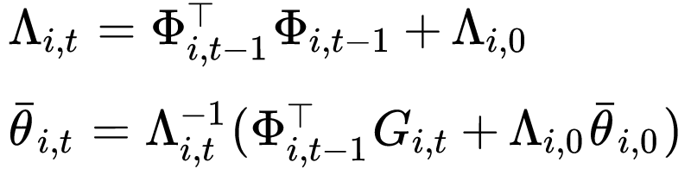
Modeling: linear meta-learning
Uncertain dynamics
Approximate model
Train a prior
Observe trajectory data
Update estimates :
Harrison, Sharma, Pavone. “Meta-Learning Priors for Efficient Online Bayesian Regression,” WAFR, 2018

Slide 14
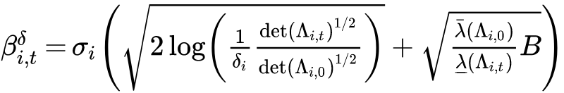




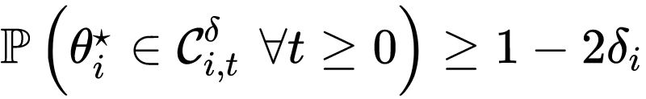

Self-normalizing martingales
Uncertain dynamics
Approximate model
Define the confidence sets
Theorem*: If the are -subGaussian and
then
with
*Adapted from Abbasi-Yadkori, Pal, Szepesvari, “Improved algorithms for linear stochastic bandits”, NeurIPS 2011

Slide 15


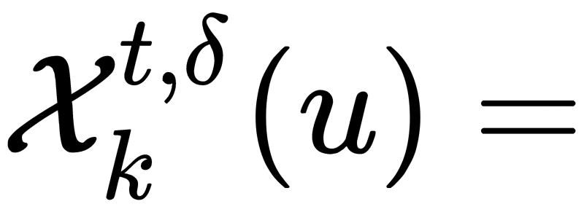
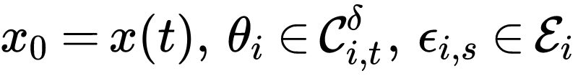
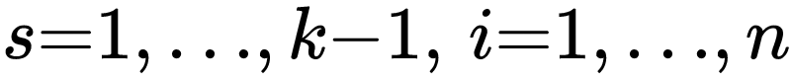
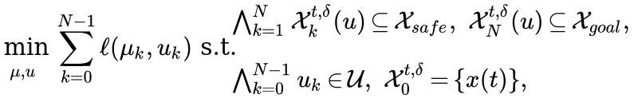
Robust planning via reachability analysis
Define the reachable sets
with ,
Define Reach-OCP(N):

Slide 16
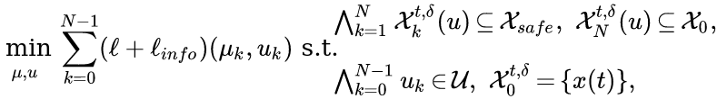
If uncertainty is too high: robust exploration
Reach-OCP(N):
Explore-OCP(N):
infeasible

Slide 17

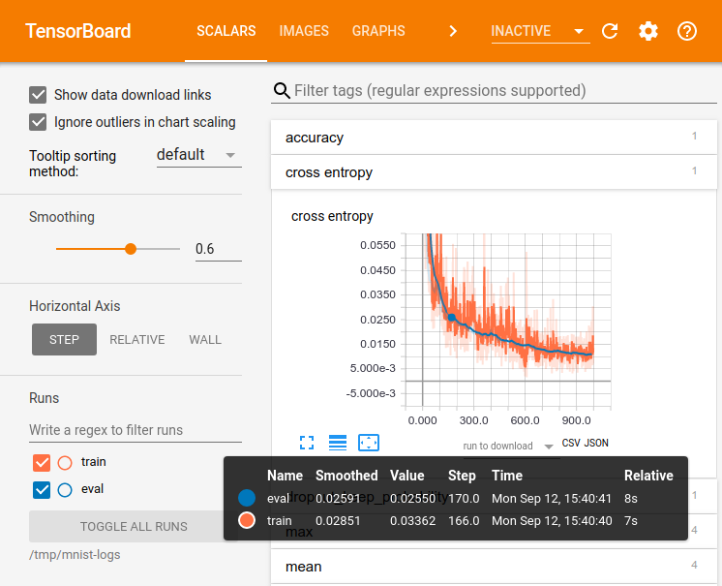
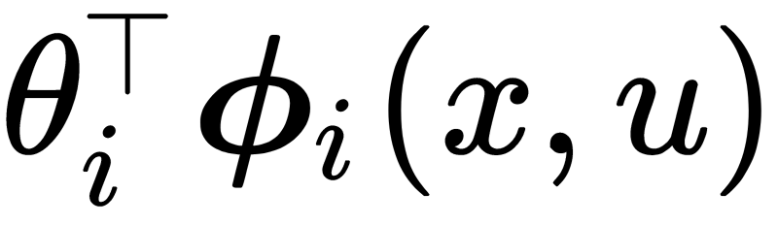

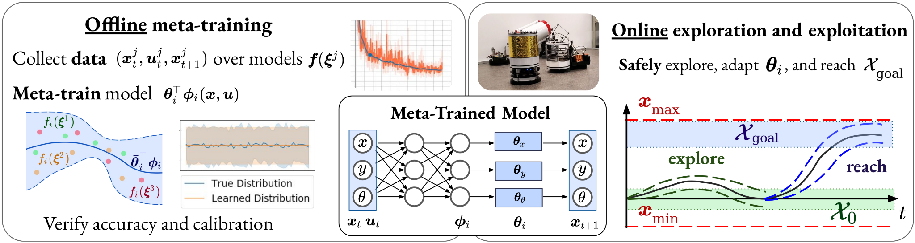

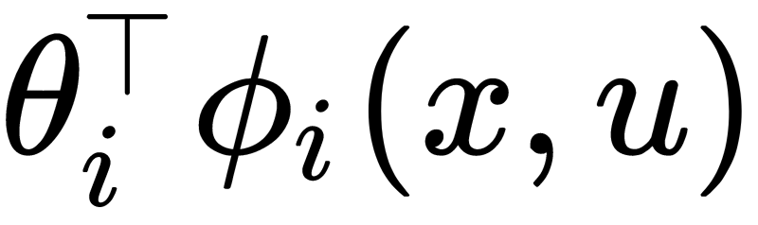
Offline: meta-train
Online: exploration - exploitation
1. Collect data
2. Train model
3. Verify accuracy
1. If ReachOCP is feasible:
Reach
2. Else, for different horizons N:
Solve ExploreOCP(N) to
Apply controls & gather data
Adapt parameters
while

Slide 18
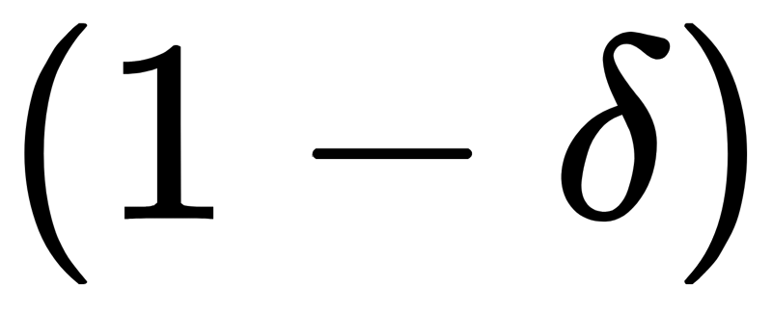
This approach is a feasible solution to the original problem
Theorem: assume that the are -subGaussian and bounded and that
Then, with probability at least :
each Explore-OCP is feasible
all constraints are always satisfied
if Reach-OCP is eventually feasible, then

Slide 19
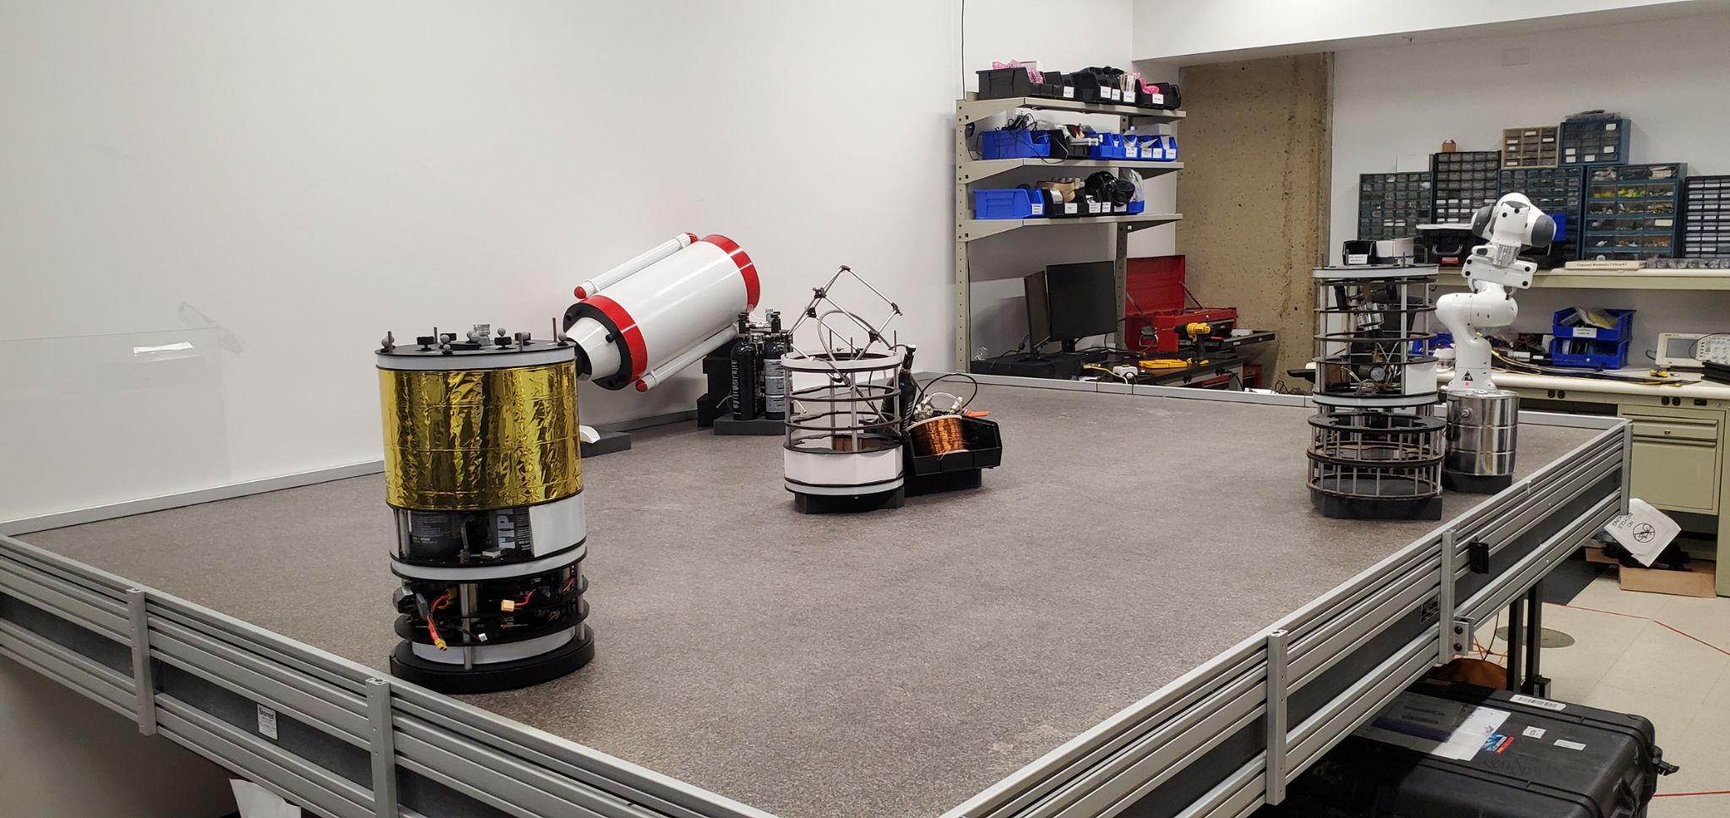
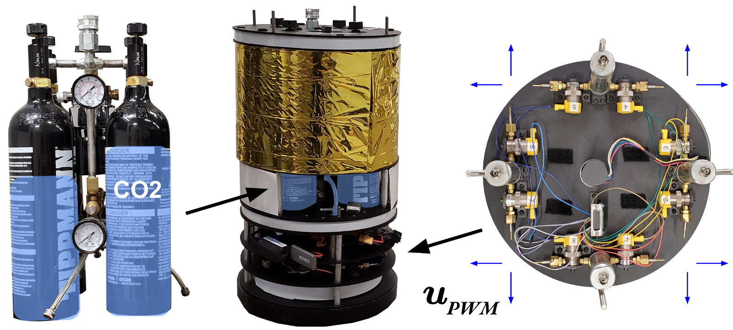
Results on a free-flyer robotic testbed
uncertainty:
CoM offset
Table tilt (constant force)

Slide 20


Slide 21
Conclusion (1st part):
Need for active learning to safely perform tasks under uncertainty
Exploit linear model structure to quantify uncertainty
Open questions:
Time to solve the problem? Regret bounds?
Efficient computation of the reachable sets accounting for parametric uncertainty?
with ,

Slide 22
Towards safe learning-based robotic autonomy
safe active dynamics
learning and control
sampling-based
reachability analysis
1
2

Slide 23
Forward reachability analysis
B. Hockman and M. Pavone, Stochastic Motion Planning for Hopping Rovers on Small Solar System Bodies”, ISRR 2017

Slide 24

Forward reachability analysis
B. Hockman and M. Pavone, Stochastic Motion Planning for Hopping Rovers on Small Solar System Bodies”, ISRR 2017

Slide 25














Applications of reachability analysis
Robust
Optimal
Control
(SCP)
Robust MPC
Robust RRT
NN Verification
Wu et al, 2022
Lew, Janson, Bonalli, Pavone, A Simple and Efficient Sampling-based Algorithm for General Reachability Analysis, L4DC, 2022

Slide 26













Forward reachability analysis
State
Control
Parameters
Disturbances
with compact
...
How to compute ?
Notes:
Continuous time formulation would also work.

Slide 27







Sampling-based forward reachability analysis
...

Slide 28






General formulation of reachability analysis
...
Input set
Reachable set
Reachability map:

Slide 29



General formulation of reachability analysis
compact reachable set to estimate
continuous

Slide 30
Related work
Applications: robust trajectory optimization, robust MPC, …
Convex over-approximations are often sufficient
Polytopic & ellipsoidal reachable sets for systems with disturbances
Problem-specific: linear/polynomial dynamics (Girard, 2005), (Chen et al, 2013), (Althoff et al, 2021)
Nonlinear: techniques that use monotonicity or bound linearization error via Lipschitz constants (Koller et al., 2018)
Difficult to account for parametric uncertainty: time correlations along state trajectories
Neural network verification community
(Chen et al, 2013), (Weimer et al, 2019), (Fazlyab et al, 2019), (Tran et al, 2019), (Ivanov, 2019), (Everett et al, 2021) developed libraries for NN verification (Flow*, Verisig, LipSDP)
How can we compute accurate approximations in milliseconds?
Sampling-based approaches (Devonport & Arcak, 2020, Thorpe et al, 2021)

Slide 31




Sampling-based reachability analysis
compact reachable set to estimate
continuous
3 parameters:
a number of samples
a padding constant
a probability measure
on

Slide 32




Sampling-based reachability analysis
compact reachable set to estimate
continuous
3 steps:
Sample inputs
Evaluate outputs
Evaluate estimator

Slide 33










Sampling-based reachability analysis
compact reachable set to estimate
continuous
Let be a probability space
Let denote the family of nonempty compact subsets of
is a
random compact set

Slide 34

Asymptotics

Slide 35
Asymptotics

Slide 36
Asymptotics

Slide 37
Asymptotics

Slide 38
Asymptotics

Slide 39
Asymptotics

Slide 40
Asymptotics

Slide 41
Asymptotics

Slide 42
Asymptotics

Slide 43







Characterizing the accuracy of the random compact set estimator
Asymptotic analysis Finite-sample analysis
-almost surely, as , with -probability at least ,
Notes:
Note: finite-sample => asymptotic bounds (but finite-sample bounds require more assumptions)

Slide 44











Theorem: Let and be a seq. of random compact sets. Assume that
For any such that :
For any open such that :
Then, -almost surely,
Ilya Molchanov. Theory of Random Sets. Springer, 2017

Slide 45






Theorem: Assume that . Then,
For any such that :
For any open such that :
Thus, -almost surely,

Slide 46

Finite-sample error bounds

Slide 47








Finite-sample error bounds
Assume:
is - convex
is - Lipschitz
for all
Then,
with
(proof via covering argument. Assumptions can be relaxed along the boundary of the input set.)

Slide 48


Adversarial Sampling
Accuracy depends on samples
=> Adversarial sampling

Slide 49





Results for neural network verification

Slide 50

Results for neural network verification

Slide 51




Applications to robust planning & control
Wu, Lew, Solovey, Schmerling, Pavone, Robust-RRT, 2022
(to appear)

Slide 52

Results: robust MPC

Slide 53


Slide 54
Sampling-based reachability analysis
simple + efficient approach for general reachability analysis
analysis using random set theory
can be used for uncertainty-aware planning and control
hardware-tested
Future work:
Tighter rates of convergence
Parallelization on GPUs

Slide 55
Towards safe learning-based robotic autonomy
safe active dynamics
learning and control
sampling-based
reachability analysis
1
2

Slide 56
Towards safe learning-based robotic autonomy
Extensions: (1) continuous-time analysis for systems modeled as stochastic differential equations (2) tighter analysis to close the theory-to-practice gap
New tools to guarantee the performance of complex autonomous systems with learning-in-the-loop components

Slide 57









Acknowledgements
Marco Pavone Riccardo Bonalli Lucas Janson Apoorva Sharma James Harrison Andrew Bylard
May 2022

Slide 58
Uncertainty-aware control strategies for
safe learning-based robotic autonomy
Thomas Lew
May 2022

